Slide 1
Radiation Test Board
Capstone Team 40: Aaron Ganus, Kenneth Chen and Stanley Lee
Texas Instruments Mentor:
Meredith McKean
Notes:
Kenneth

Slide 2
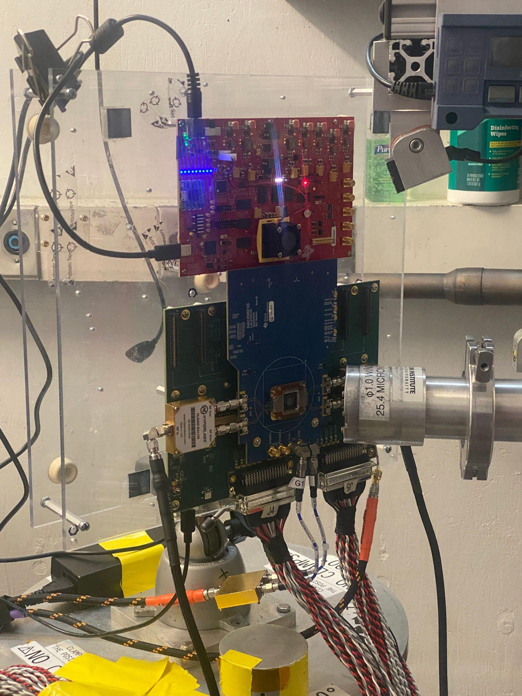
Problem Statement
There needs to be efficient radiation testing to improve electronic component reliability in high-radiation environments, particularly for the growing space travel industry.
Current TAMU Cyclotron test procedure consists of an ion beam being shot at a Device Under Testing (DUT) while the temperature and current/voltage readings are monitored.
Testing at the TAMU Cyclotron facility costs thousands of dollars per hour but only one device at a time can be tested. If a new device is to be tested, personnel must physically swap out the DUT after the laser is powered down, wasting time and money.
Notes:
Stanley

Slide 3
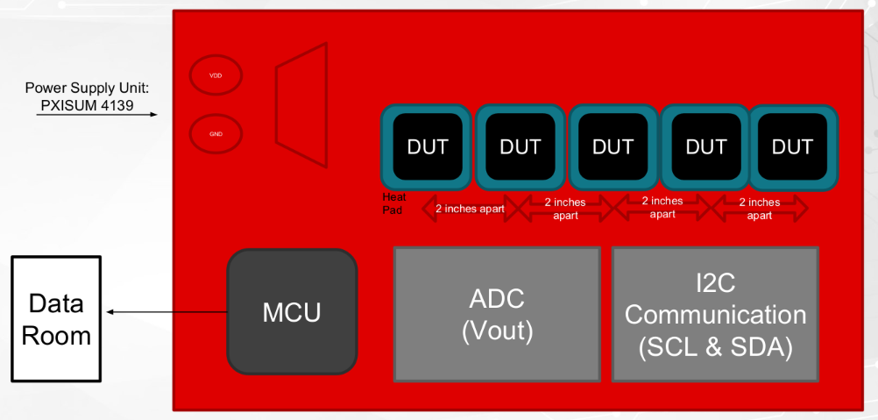
Proposed Solution
A radiation test board capable of holding and monitoring multiple test devices without the need for personnel to physically swap out components between tests.
The Cyclotron test platform the test board sits on is can be remotely controlled from the monitoring room, allowing each DUT to be moved into the path of the beam. Each DUT and its heating pad will be powered as needed via a switching mechanism.
Notes:
Aaron

Slide 4
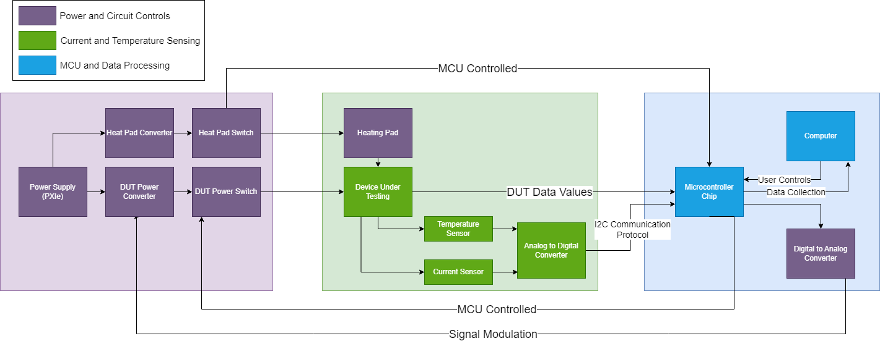
Initial Subsystems Diagram

Slide 5
Power and Circuit Controls
Goals:
Design a means to select a DUT out of a set of DUTs
Design a means to adjust the voltage output levels per each respective DUT
Design a means to adjust the voltage input to enable a heating source to reach a specific DUT temperature
Notes:
Aaron

Slide 6
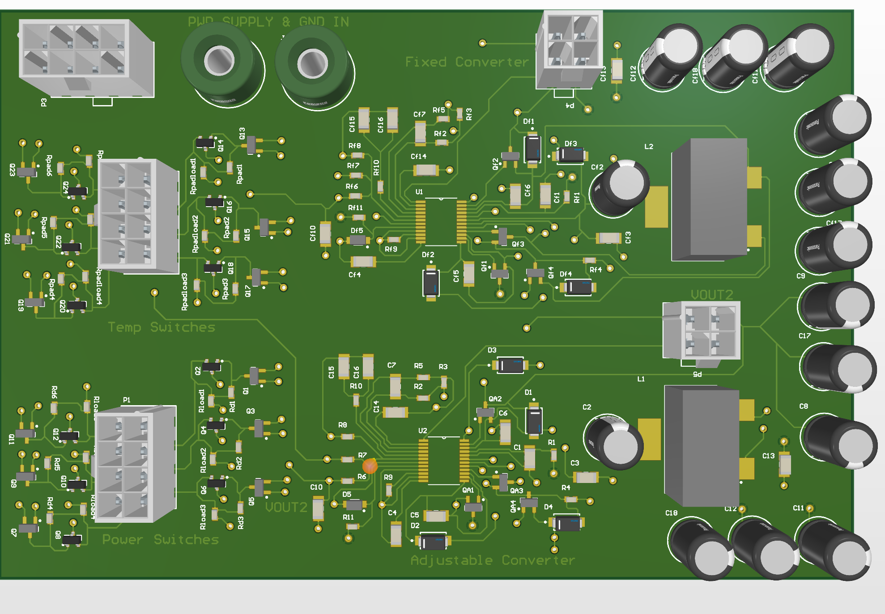
First Semester Review
DUT Switching Mechanism
12 Switches with six designated for Temperature Control and the other six for Power Control
Each power switch is paired with a temperature switch for each DUT
Each power and temperature switch pair can be activated via MCU communication
Buck-Boost Converters (2)
DUT voltage regulation and Heating source regulation
Notes:
Aaron

Slide 7
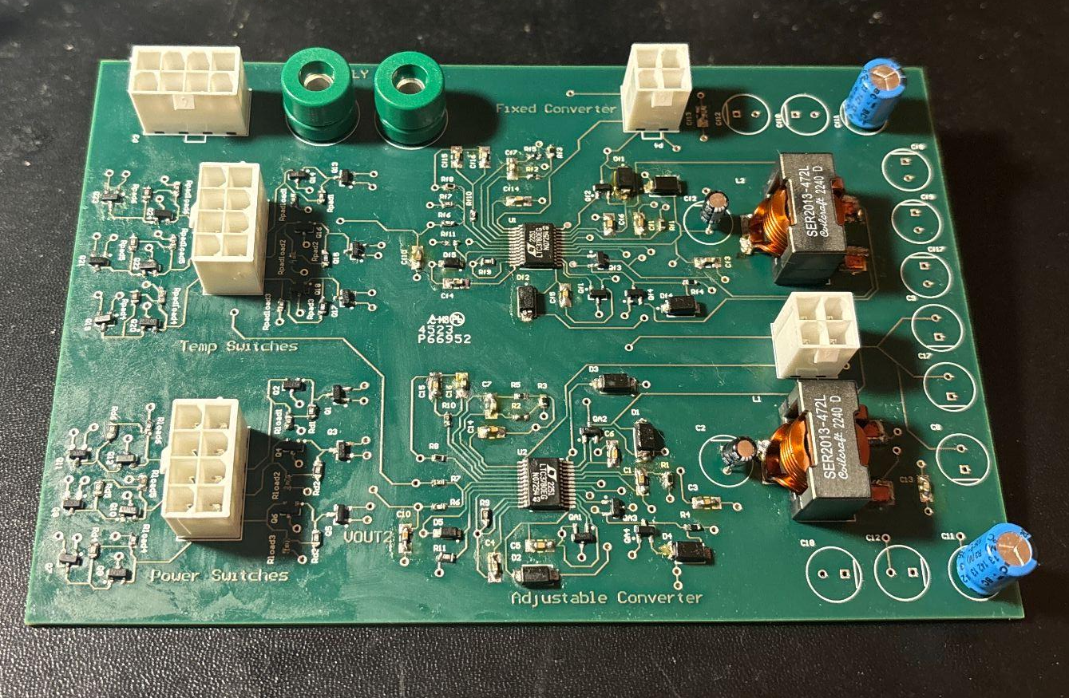
First Semester Review
Lessons Learned:
If high-voltage regulators are needed, pick parts that are configured for high power consumption
DUTs are low current devices and the Buck-Boost Converters could be replaced by several LDO regulators

Slide 8
MCU and Data Processing
Goals:
SPI protocol to read in sensor data and operate Ethernet W5500 Connection
I2C protocol to control power and read sensors
PC Application with GUI to control the system.
Notes:
Kenneth

Slide 9
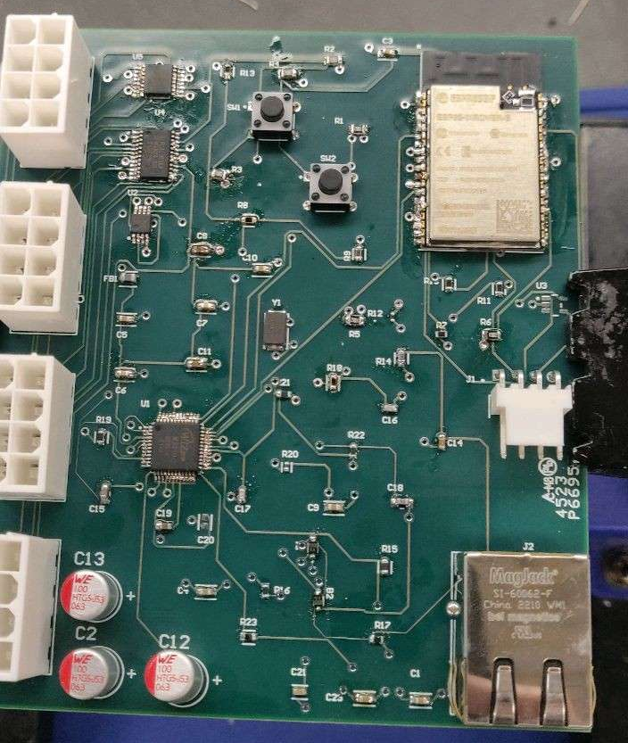
First Semester Review
ESP32 WROVER E: MCU Chip
W5500: LAN Ethernet TCP/IP Control chip
SN74LV4051APW: Mux/Demux chip for selecting between Aaron’s six control switch pairs
PCA9535 PW118: I/O Port Expander

Slide 10
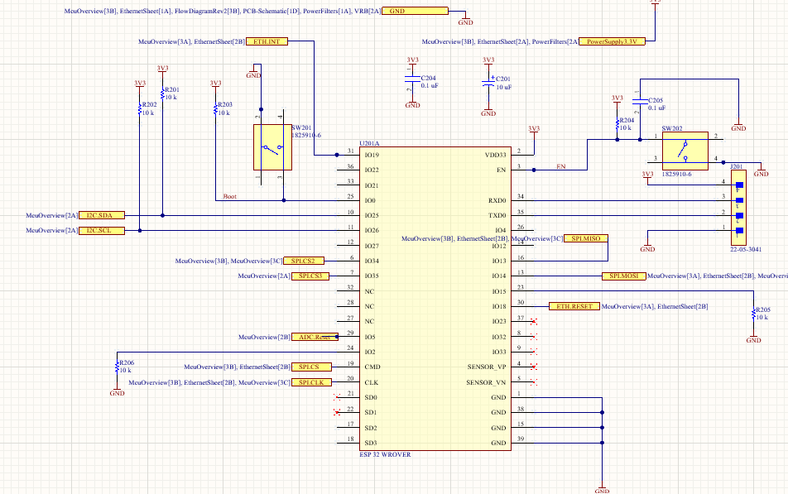
First Semester Review
Lessons Learned:
Shorting caused USB serial cable to smoke and for code uploading to be impossible
Mistakes on schematic required cut trace and new wire connections.
Notes:
Kenneth

Slide 11
Current/Temperature Sensing
Goals:
Create the socket for the DUT to plug in and be able to be powered and read using I2C
Record the actual temperature value using thermistors which are sent to an ADC (AD7718) to be converted to a digital signal
ADC to read current and voltage along with any additional analog signals
Developing the coupon board for the DUT (TMP117) to be placed on the board
Notes:
Stanley

Slide 12
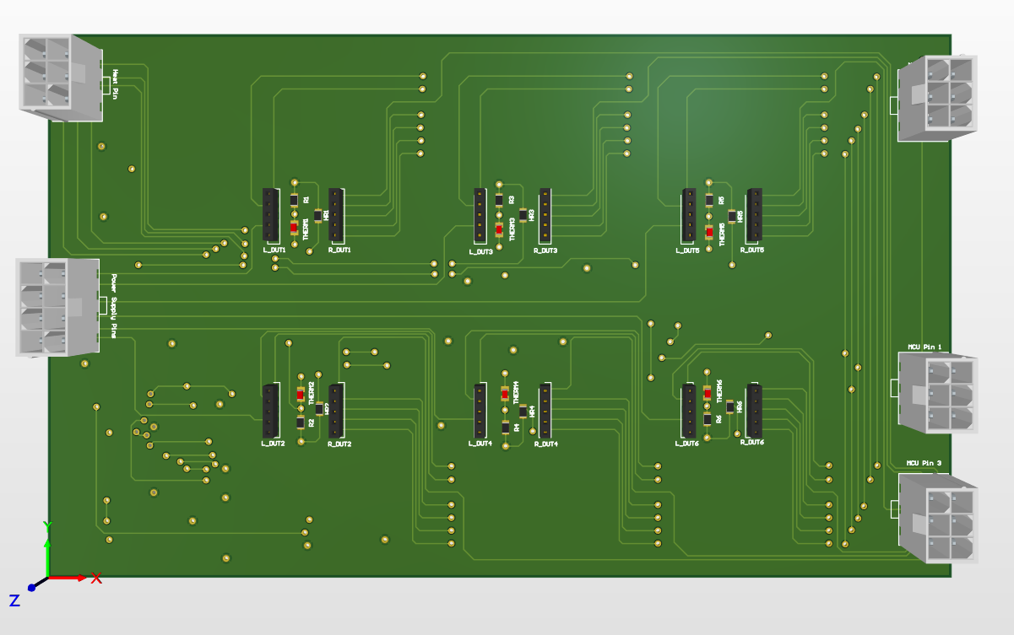
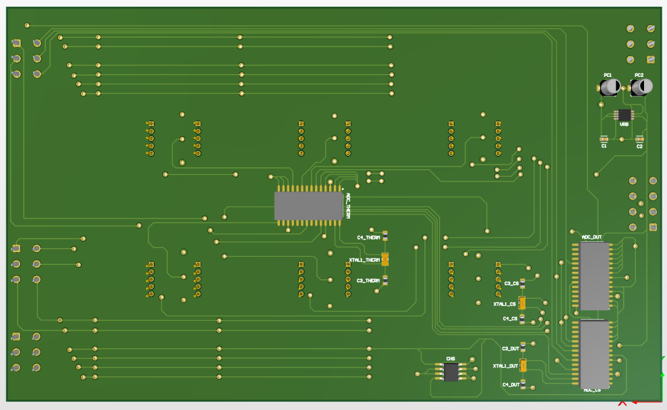
First Semester Review
6 DUT sockets with I2C, power, ground, SPI, analog
ADCs for thermistors and analog output
Current and voltage sensor to record the power consumption of the DUTs
Notes:
Stanley

Slide 13
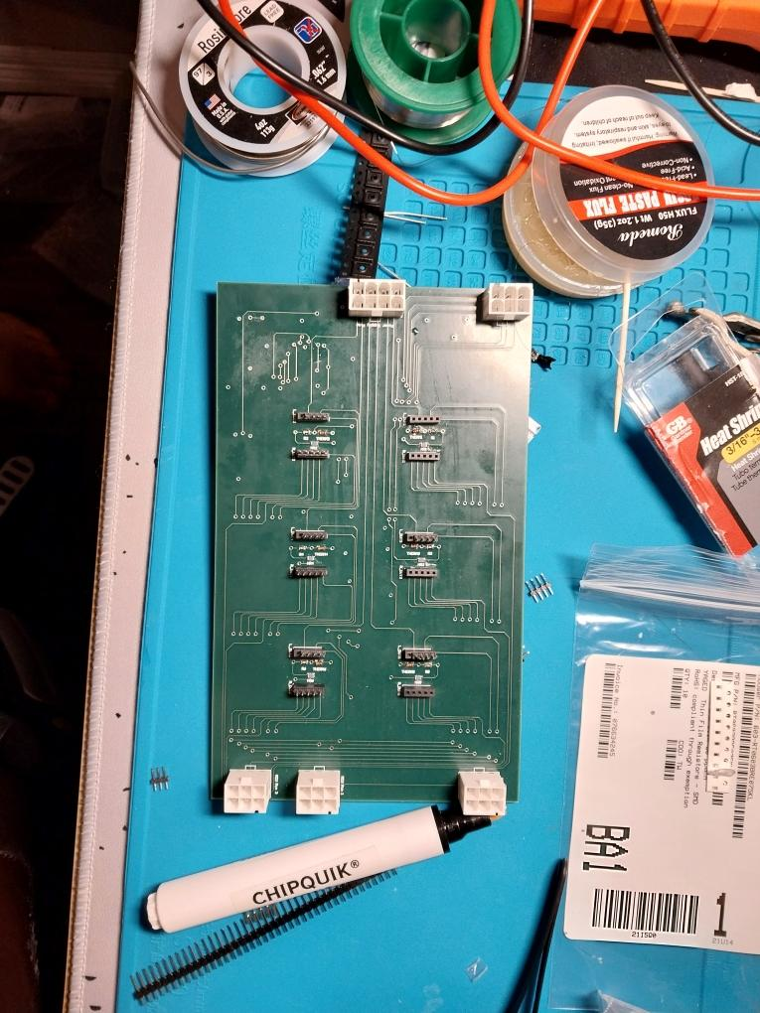
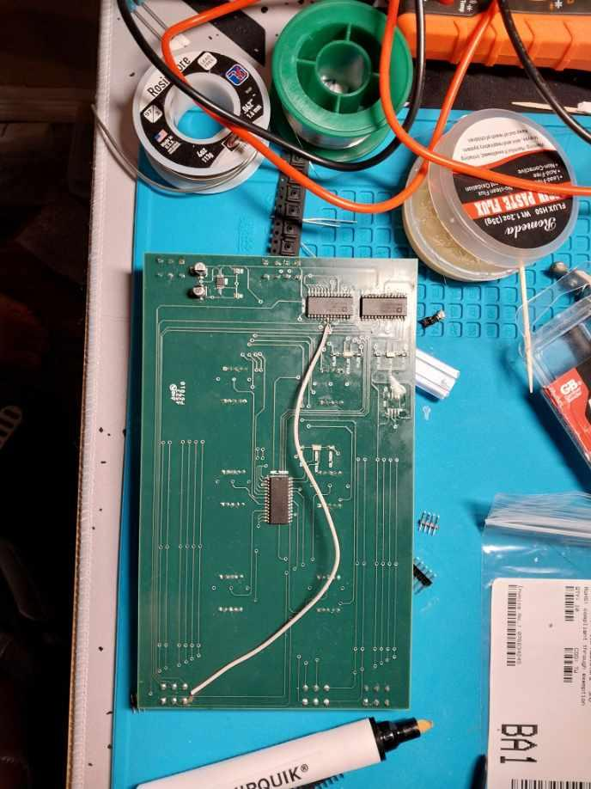
First Semester Review
Lessons Learned:
The amount of ADC’s can be reduced as it is too complex and ADC is too close to the DUTs as it could overheat
Shorting to the heating element caused it to not worked properly
Oversight of how the AD7718 functioned required a cut trace and short. More careful consideration of routing is needed.

Slide 14
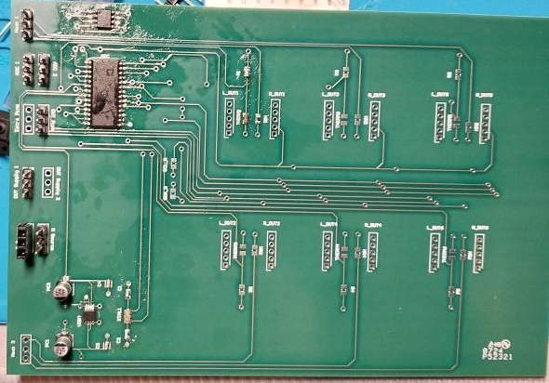
Second Board Review
Improvements to heating resistor to provide more stable power
Reduced the amount of ADC’s to reduce board size and complexity
Easier pins for testing

Slide 15
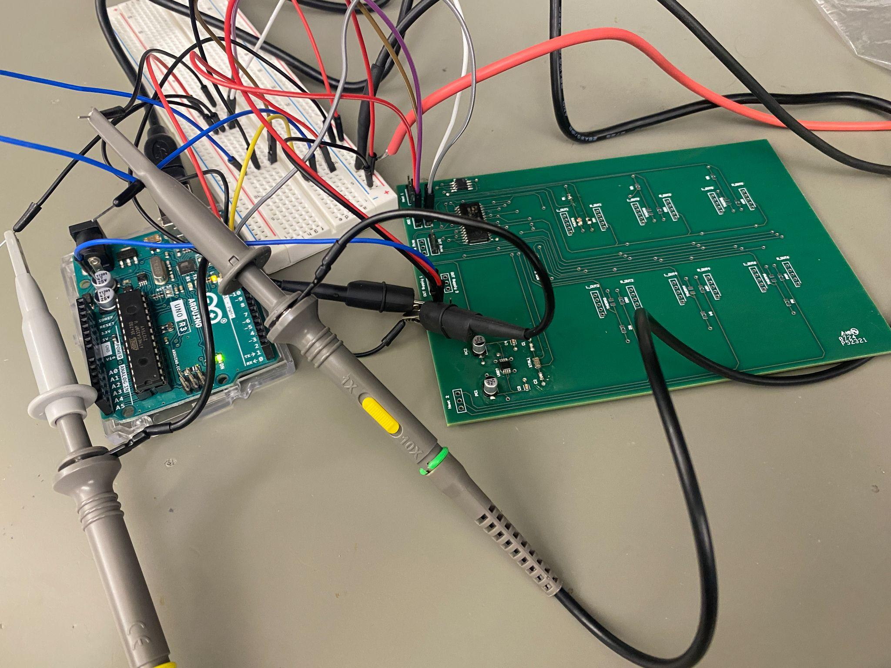
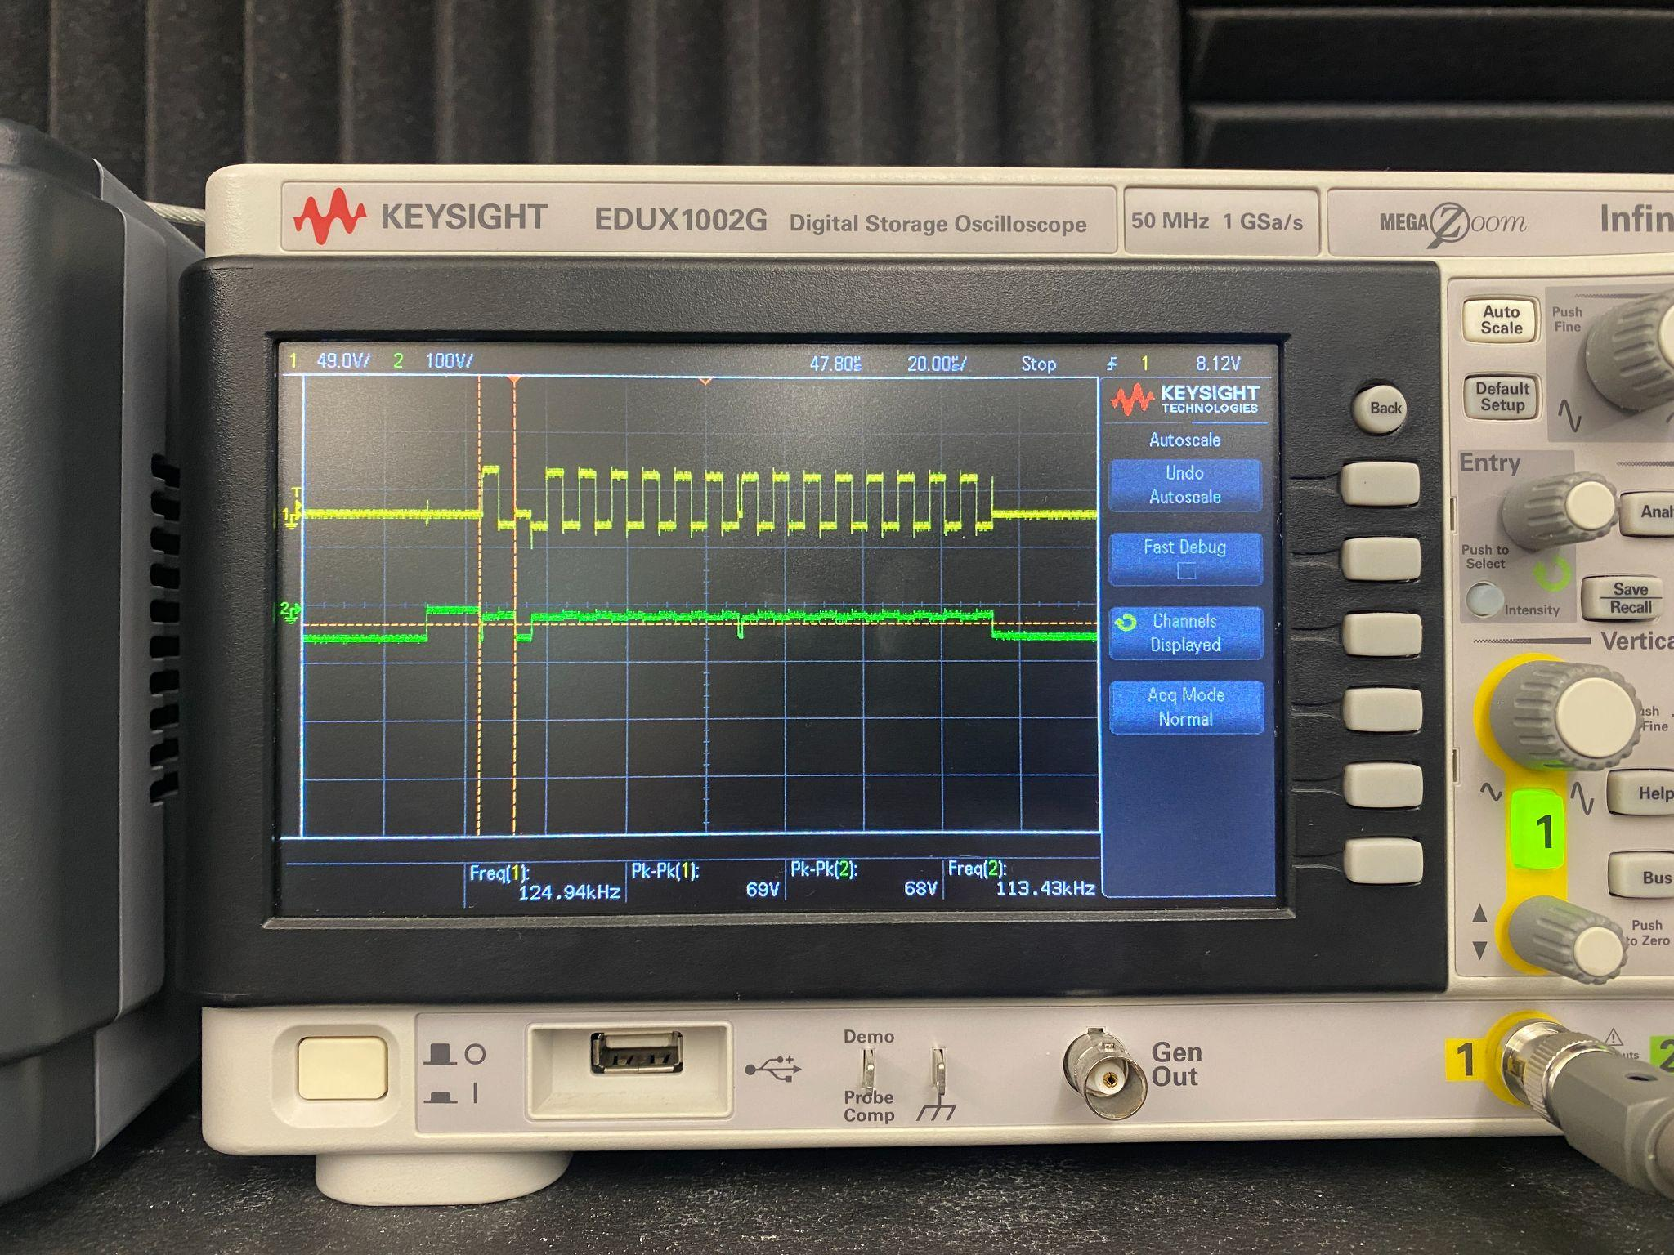
Second Semester Review
Lessons Learned:
Resistors need to be big and lifted to properly heat up the coupon board. A through hole resistor can solve this issue
Careful routing needs to be considered to prevent shorting the clock signal for no interference

Slide 16
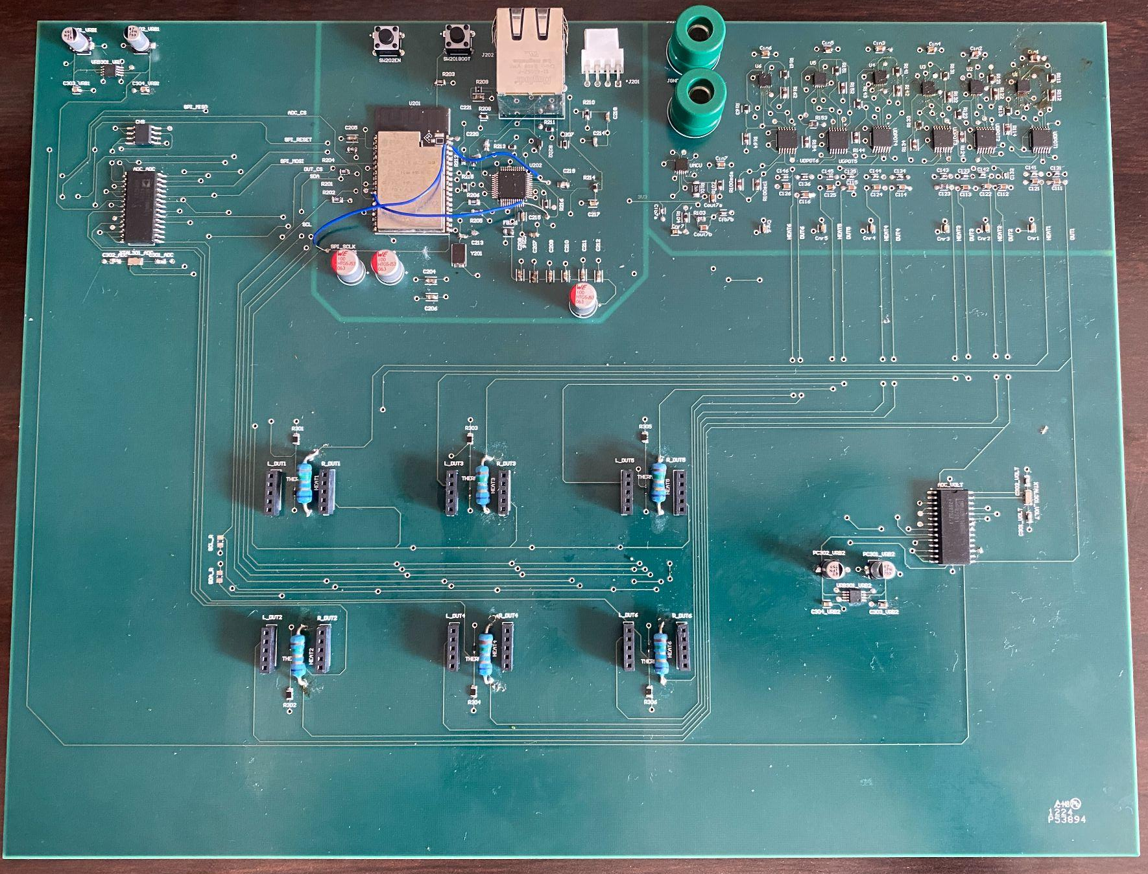
Integrated Board
Redesigned Power Controls configuration which eliminated previous design issues and reduced potential failure points
Removed demux and I/O expander from MCU due to power controls redesign
Placed better resistors that can heat the DUT more efficiently
Replaced thermistors with TI thermistors for easier programming for TI’s systems
Notes:
Stanley

Slide 17
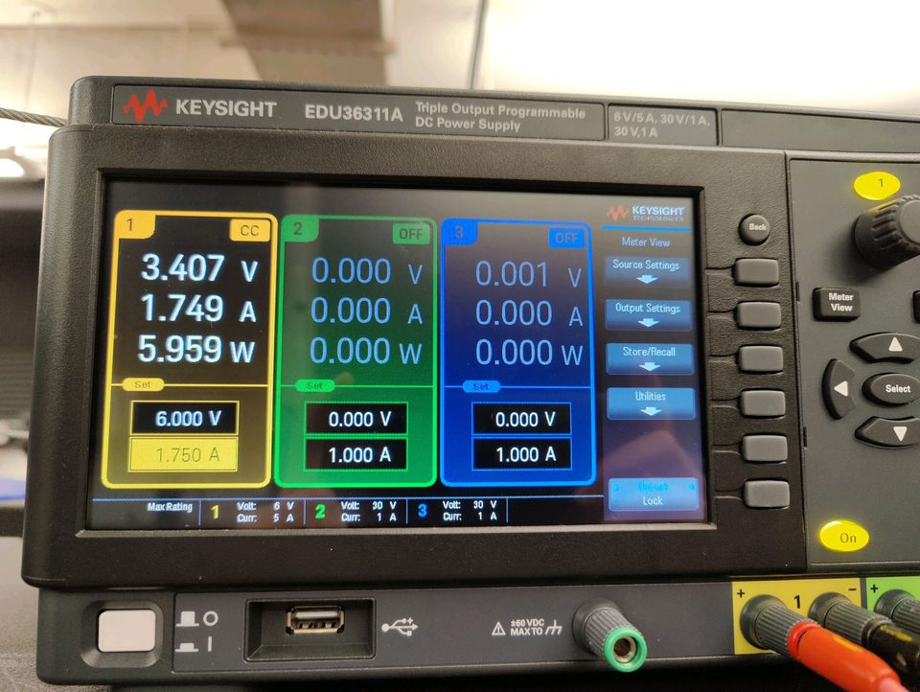
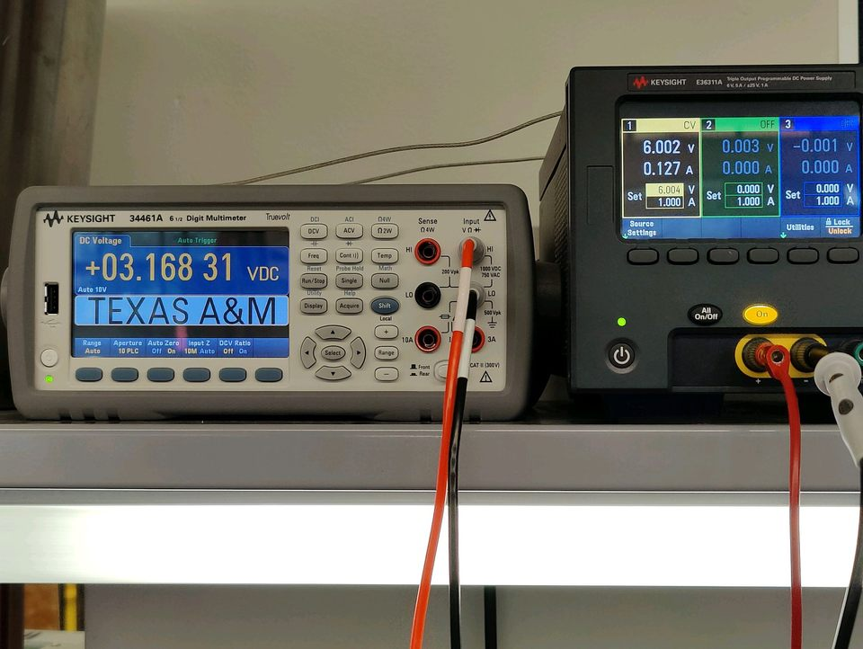
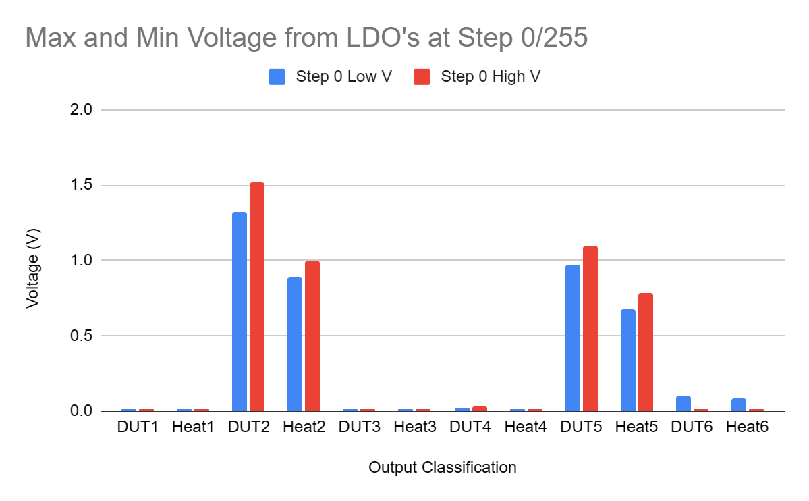
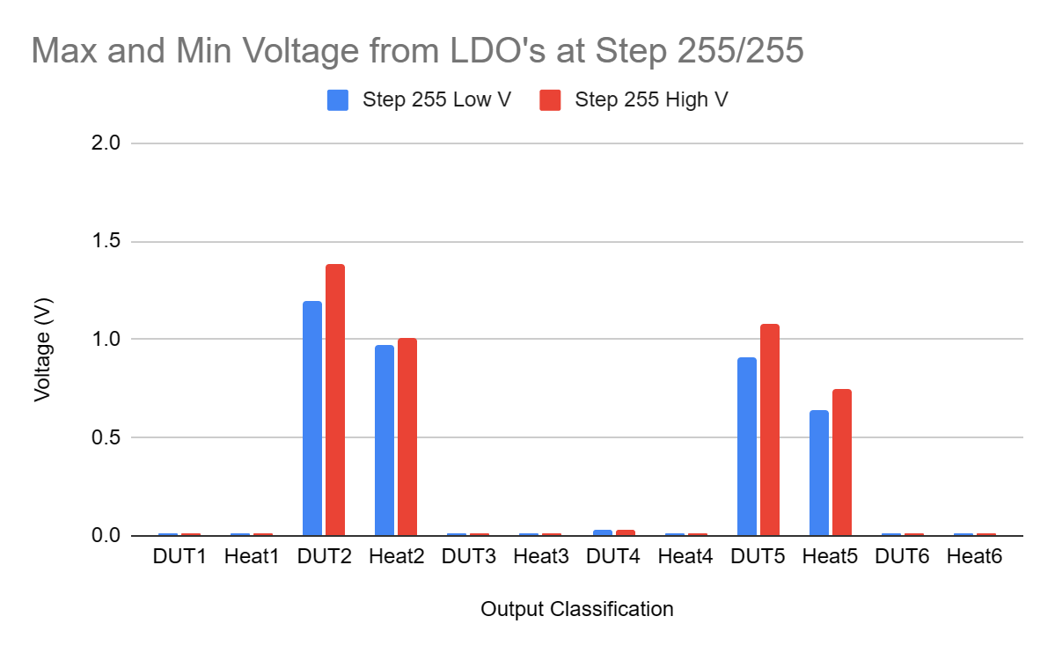
Results and Conclusions
LDOs are outputting voltage to DUTs and awaiting MCU for ability to enter full scale range testing using the digital potentiometers (I2C). In addition, MCU is currently only detecting 4 LDOs

Slide 18
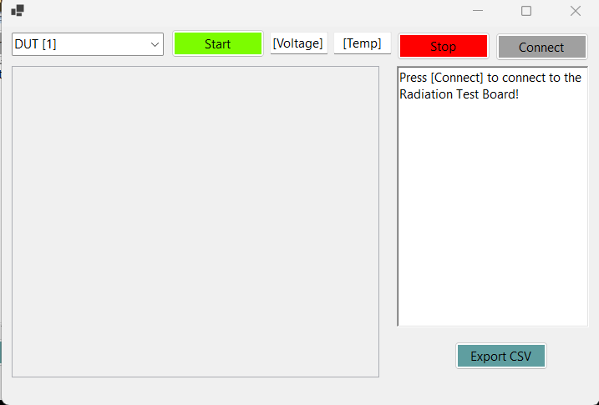
Results and Conclusions
PC app GUI is done, MCU communication is currently being debugged.
Routing issues required trace cutting and blue wire, but now works.
MCU can write to Digital Potentiometer steps.
MCU can read in SPI Data from ADC and I2C data

Slide 19
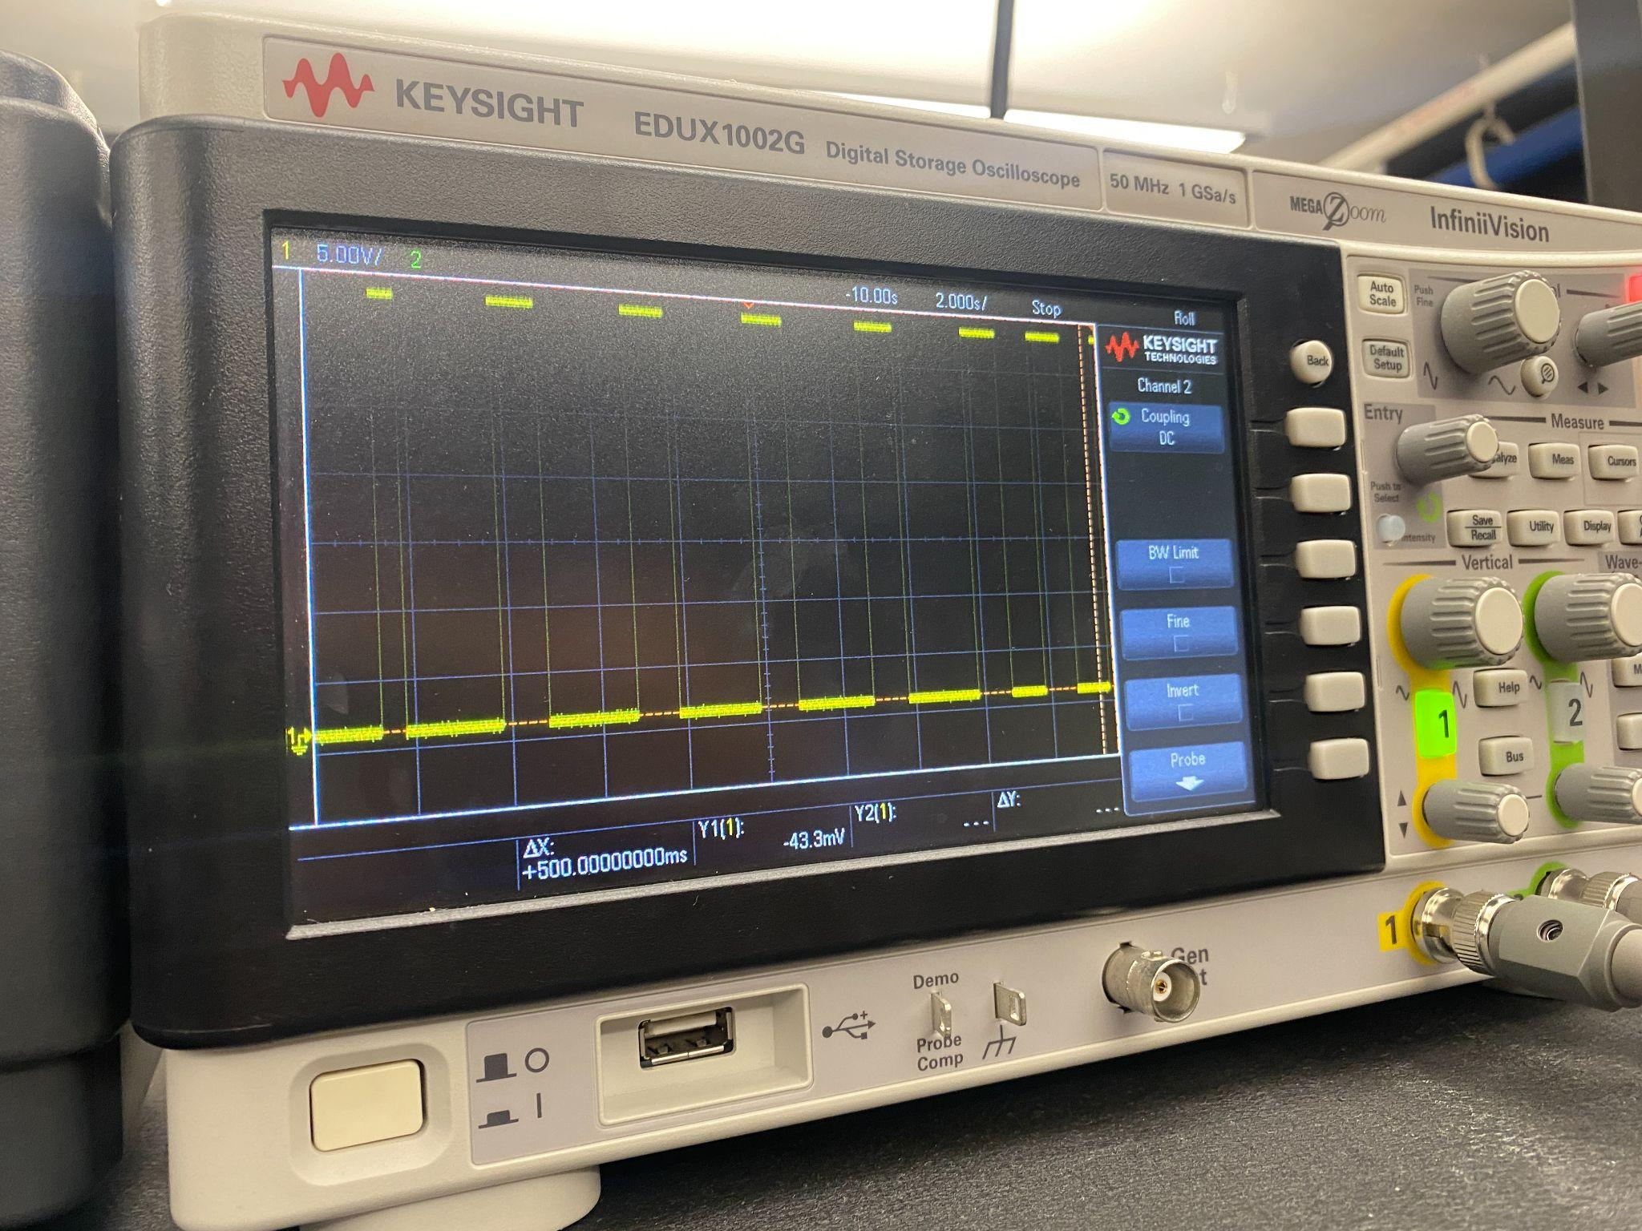
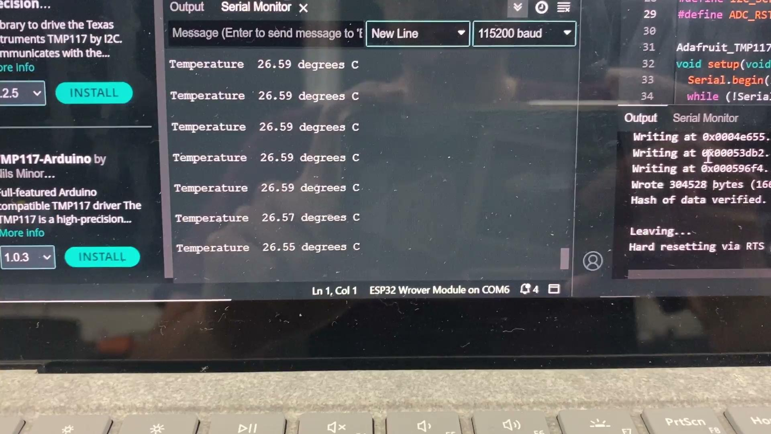
Results and Conclusions
The ADC had a clean output and input signal, however, before the chip select was not working. Though once the issue with chip select was fixed, an output on the oscilloscope does not show. Which prevents gathering data.
The heating resistors do heat up, but due to the power switching not working properly, it cannot get the correct voltage to run the resistor.
Coupon board reads the temperature chip correct and can gather data from it.

Slide 20
Demo

Slide 21
Questions?

Slide 22
Thank you!

